Slide 1
Extract Dependecy – writing a program for ‘Include’
Online Calculator
Compare Dependency
Compute Sample Size
Randomly pick a number of classes to examine
Conclude Finding
Extract Dependecy – using ‘Understand’
Compare Dependency
Compute Sample Size
Randomly pick a number of classes to examie
Extract Dependecy – using Idea
LEGEND
State
transition

Slide 2
Understand vs. Idea
 | Intersect | Excluding | Total
Undertand | 50538 | 11696 | 62234
Idea |  | 889 | 889
Total Dependencies | 63123

Slide 3
Understand vs. Include
 | Intersect | Excluding | Total
Undertand | 40404 | 21830 | 62234
Include |  | 889 | 889
Total Dependencies | 63123

Slide 4
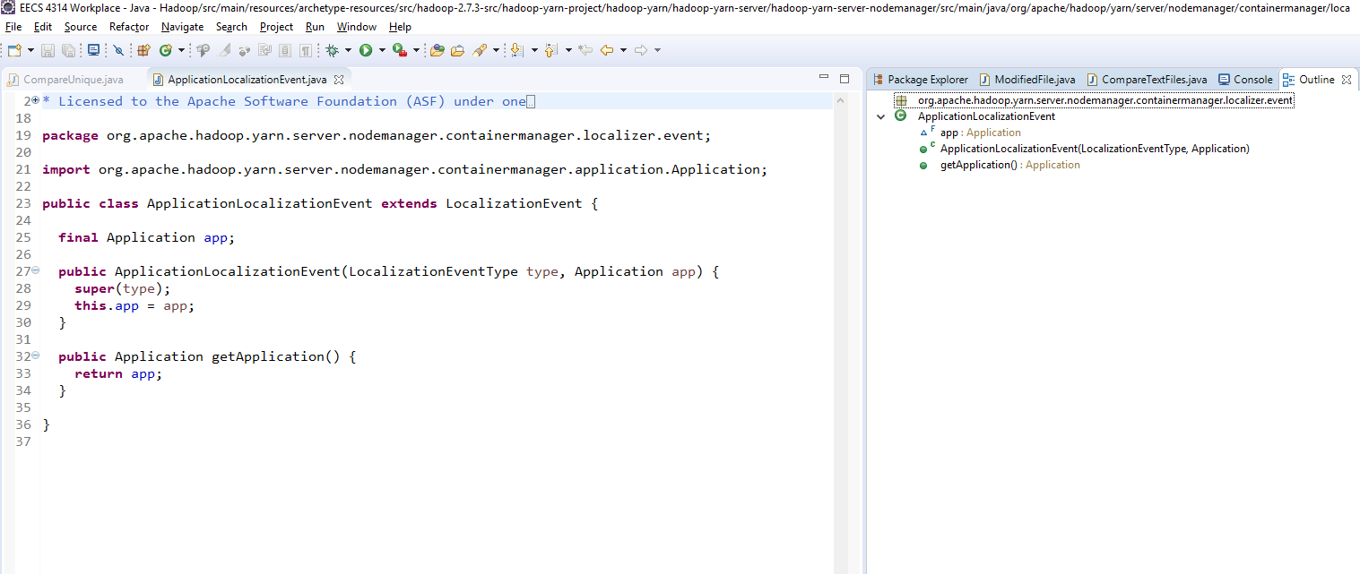

Slide 5
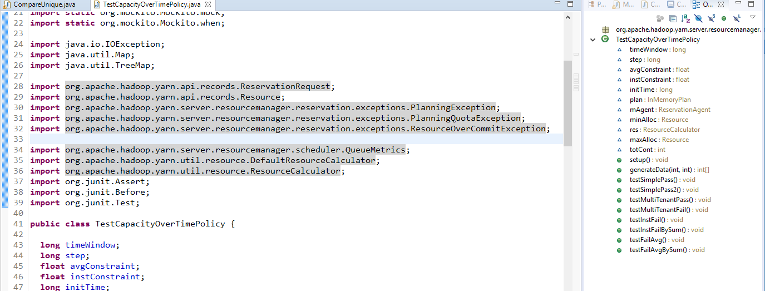
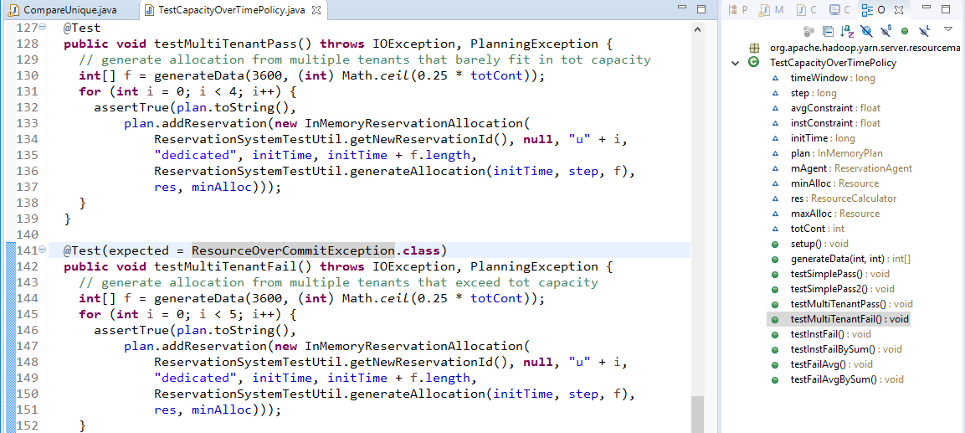

Slide 6
